Slide 1
AXIS - QA CAPSTONE project
TEST TITANS
Group 5
Rutuja Jejurkar
Anjana Krishna
Suyog Waghere
Sourabh Desai
Swapnil Duparte
Program Coordinator
Ronak Ron
Faculty
Navin Kumar

Slide 2
CONTENTS
Introduction
Project Overview
Case Study 1 (SQL)
Case Study 2 (Manual Testing)
Case Study 3 & 4 (Automation Testing)
Additional Case Study
Tools Stack
Conclusion

Slide 3
INTRODUCTION
Quality Assurance (QA): QA ensures each part of the software development process meets quality standards and works correctly.
Manual Testing: Testers manually check the software for issues. This is useful for finding unexpected problems, especially in design and usability.
Automation Testing: Automation uses tools to run tests automatically, ideal for repetitive tasks like regression testing, saving time and reducing errors.
Structured Query Language (SQL): SQL helps manage and work with data in databases effectively.

Slide 4
PROJECT OVERVIEW
Create and manage an SQL table for customer data.
Manual creation of high-level test cases to verify core functions on indigo’s website - goindigo.com
Automate a Website with Selenium (Java) - testautomationpractice.blogspot.com
Automate the “Yahoo account creation” process with Selenium (Java) - login.yahoo.com
Automation for XYZ Bank website using Selenium and TestNG - xyzbank.com [Add on]

Slide 5

Case Study : 1
“Why is this data so messy? How can I arrange it?”
Here is the Solution!!!
Structured Query Language (SQL)
Aggregate Functions
DDL
DML
Sub Queries

Slide 6

Case Study : 2
"Hi everyone! What's the most effective approach to thoroughly test a website for interface issues and assess the user experience?”
Manual Testing
Test Scenario
Test Case
Result
Bug (If any)

Slide 7

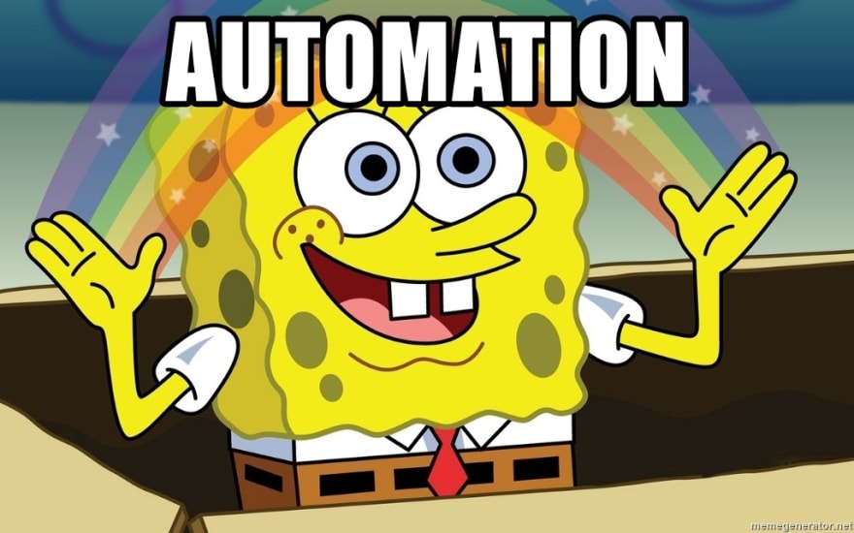
Case Study : 3 & 4
“Hey, I’m fed up with Manual Testing Works! Is there any alternative method?”
Automation Testing
Selenium
WebDriver
ChromeDriver

Slide 8
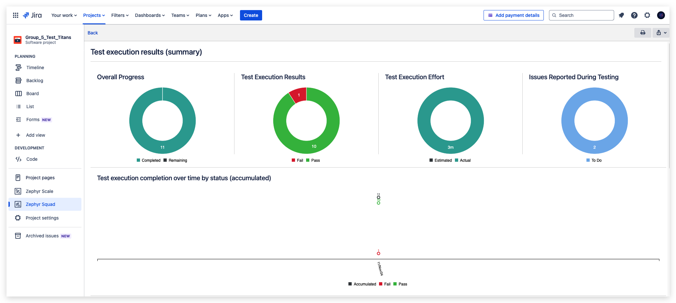
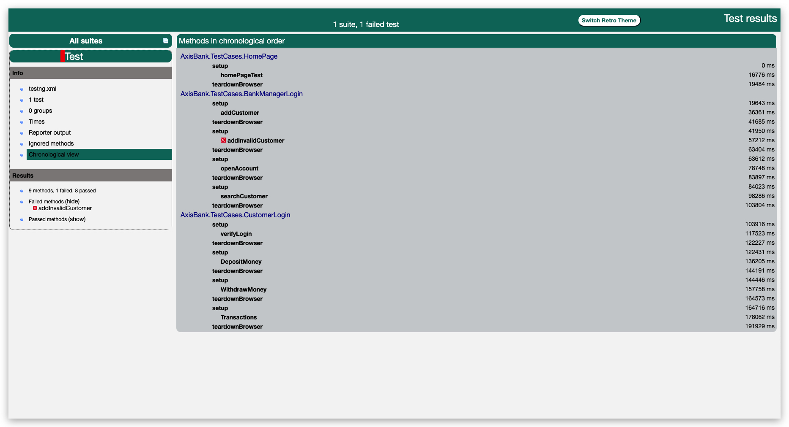

Extra Case Study
Primary objective: Test and ensure the correct functionality of GlobalsQA Banking Project
Manual creation of test cases on Jira
Automation of these test cases
Integration with a Hybrid Framework

Slide 9
Tools Stack
Eclipse IDE
Selenium (Opensource Automated Testing Tool)
Programming Language – Java
SQL Server Management Studio / Azure Data Studio
MS Excel
GitHub
TestNG
JIRA (Zephyr Squad)

Slide 10
CONCLUSION
Automation streamlined repetitive tasks, reduced errors, and improved testing efficiency, leading to faster test runs and better quality.
Manual testing caught issues early, ensured smooth website functions, provided user insights, and validated complex scenarios.
In SQL, we focused on data integrity, query validation, and performance, ensuring accurate data handling and stability.
Overall, QA is crucial for ensuring a high-quality, bug-free product.

Slide 11
Important LinkS
GitHub Link: Axis Bank Case Studies Project (https://github.com/suyogwaghere/AxisBank_Case_Studies)
GlobalsQA: https://www.xyzbank.com

Slide 12
Thank you
“Hey, don’t worry! The Quality Analysts are here to test and deliver a bug-free product.”

